Slide 1
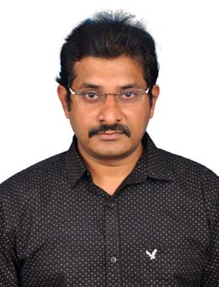
Professional Snapshot
Venkata Ramesh Padala
Associate Tech Specialist, TechM
Master of computer Application (M.C.A)
12 years 8 months of IT experience with 3.8 years in GE (Power, Digital and Renewables)
Facilitated Projects in various Roles:
  Full Stack Developer
  Database Developer
  UI Technical Lead
  AWS Cloud Developer
Currently working on Digital Inspection - camera is an economical solution to use multipurpose inspecting thermal machinery for security.
Current Location
Hyderabad, India
Experience Summary
Domains: Health Care, Banking, Finance, Automobiles, Electronics
UI Technologies: Angular, React, Redux, Vue, Node Js, Express
Ticketing Tools: Rally, Jira
Programming Languages: Java, Spring Boot, Microservices
Testing Tools: Karma, Jasmin, Jest
Database Technologies : MySQL, PostgresSQL
Cloud Technologies : AWS (VPC, S3 , EC2, SNS, Cloud Watch)
Version control software tools : GIT, SVN
GE Project Snapshot
This digital inspection camera allows to get a clear view inside analog gauge and thermal from wallboard.
Certifications
Java Full Stack with Spring Boot and React
Advanced JavaScript
MERN Full stack Development
The Complete Modern JavaScript Course

